Slide 1



SOFTWARE DEVELOPMENT PROFESSIONAL PROGRAM
Objects & Properties

Slide 2





Objects & Properties
Learning Objectives
Define an object.
Access properties of an object.
Compare and contrast objects and arrays.

Slide 3

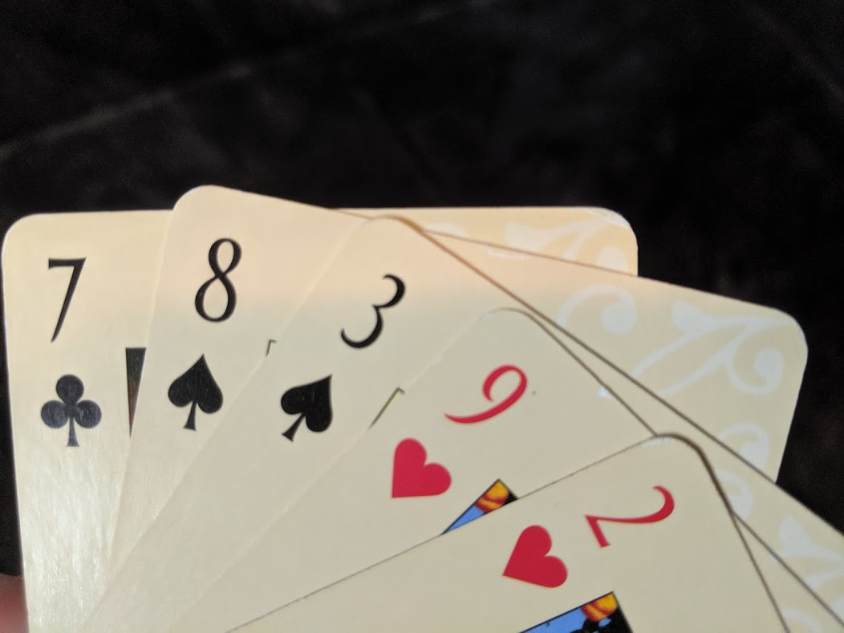

Objects & Properties
Cards
What is the suit of the highest-numbered card in this hand?
Notes:
In the last lesson, we represented cards as an array of numbers.
But by doing this, we've lost information about each card. Even though *we* can look at this
hand of cards and figure out the suit of the highest-numbered card, when we represent the
cards as an array of numbers, there's no way for the computer to find that same information.

Slide 4
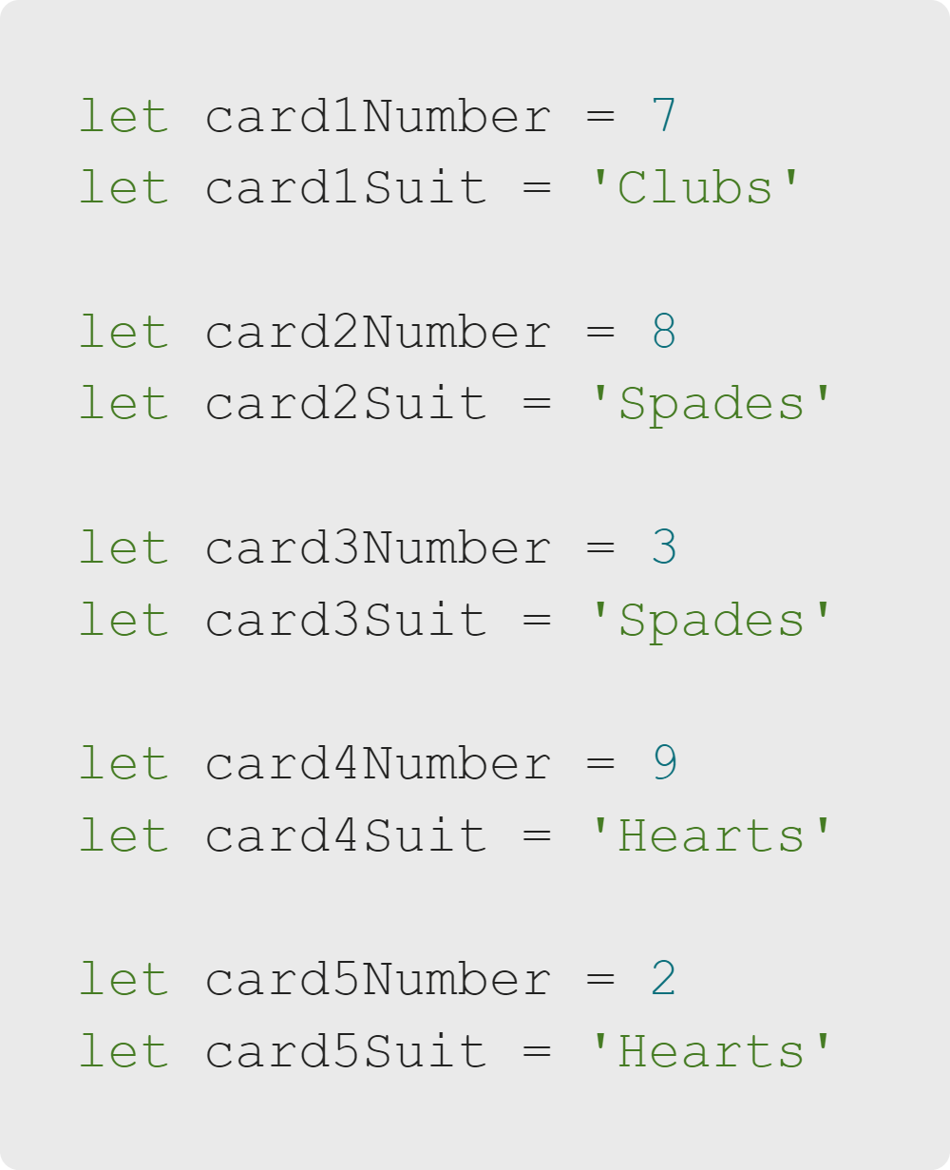
Objects & Properties
Representing Card Data
Notes:
We could use two variables to describe the card number and suit.
But it would make representing multiple cards pretty impossible.
We'd have no way to effectively group these variables into arrays, pass them around in our program, etc.

Slide 5

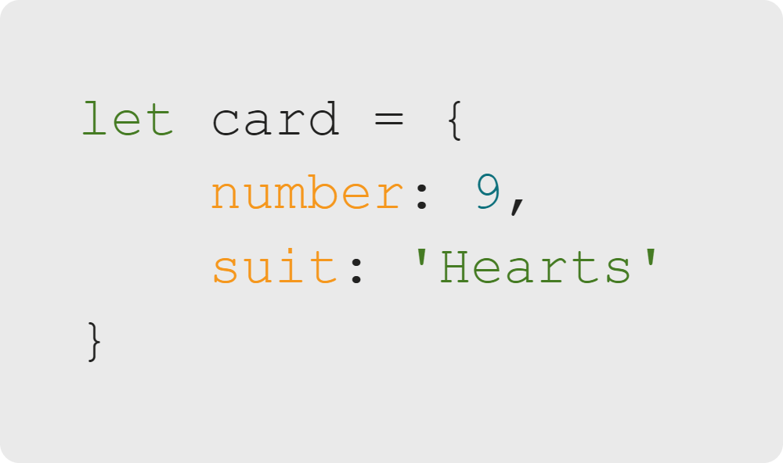
Objects & Properties
Objects
Defined with "{}"
Container for other variables
Called properties
Can represent real-world objects
Like playing cards
Notes:
Objects help with this.
Here are some of the key features of JavaScript objects.
<<Exercise 01--declare a variable that's an empty object>>

Slide 6

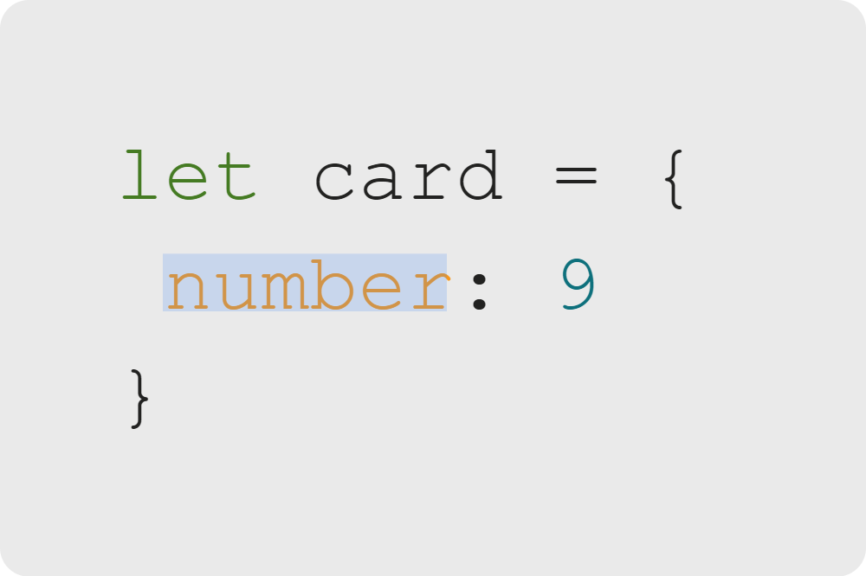
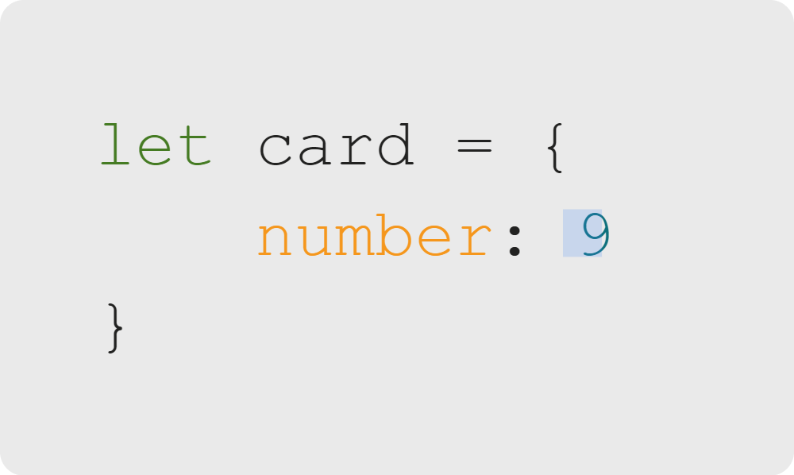
Objects & Properties
Defining Object Properties
Property Name
Property Value
Or, Property Key
Notes:
Every property of an object has a name (or key) and a value. You'll often hear a property described as a 'key: value pair'.
Keys are unique to the object and are often used as a descriptor for the value.
<<Exercise 02--make an object with one property>>

Slide 7
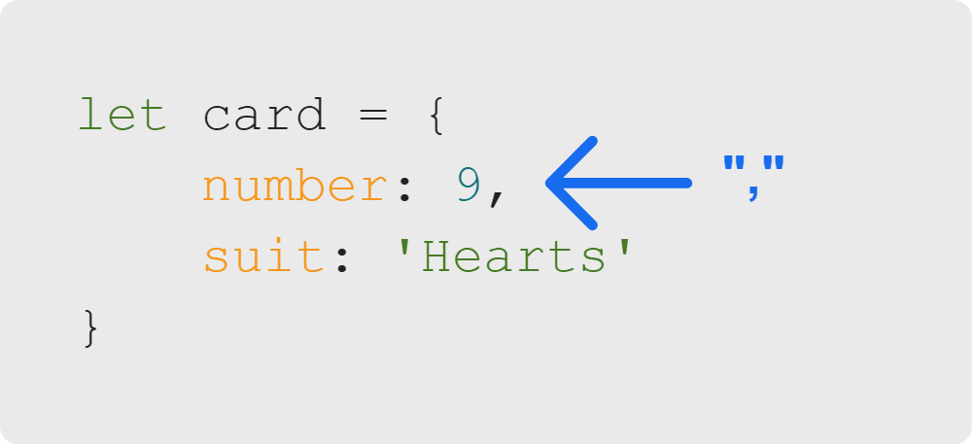
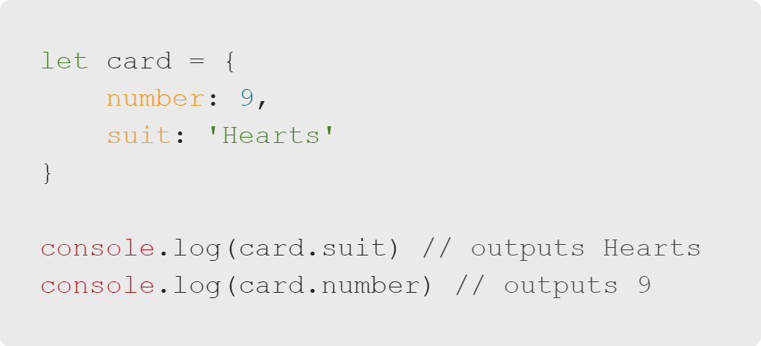
Objects & Properties
Defining and Accessing Multiple Properties
Separate properties with a comma.
Access each property by name.
Notes:
The properties inside of an object are separated by commas.
An object can have any number of properties.
Property values can be any type of variable: strings, numbers, Boolean, etc.
You can even store functions, arrays, or other objects!
After an object has been defined, we can access the value of one of its properties using the properties name/key.
1. Card references the object defined on lines 1-4.
2. The '.' operator tells JavaScript to look inside that object.
3. 'suit' brings back the value of the property named 'suit.'
* As you might expect, this means that property names, much like variable names,
should be unique within the object.
<<Exercise 03--make an object with multiple properties>>
<<Exercise 04 and 05--access a specific value in an object>>

Slide 8
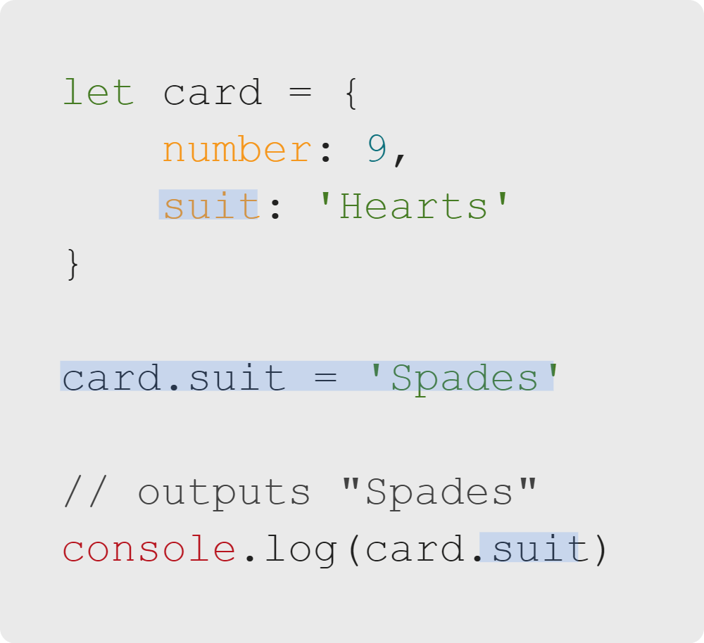
Objects & Properties
Changing Property Values
You can change property values by accessing the value and setting it to a new value.

Slide 9

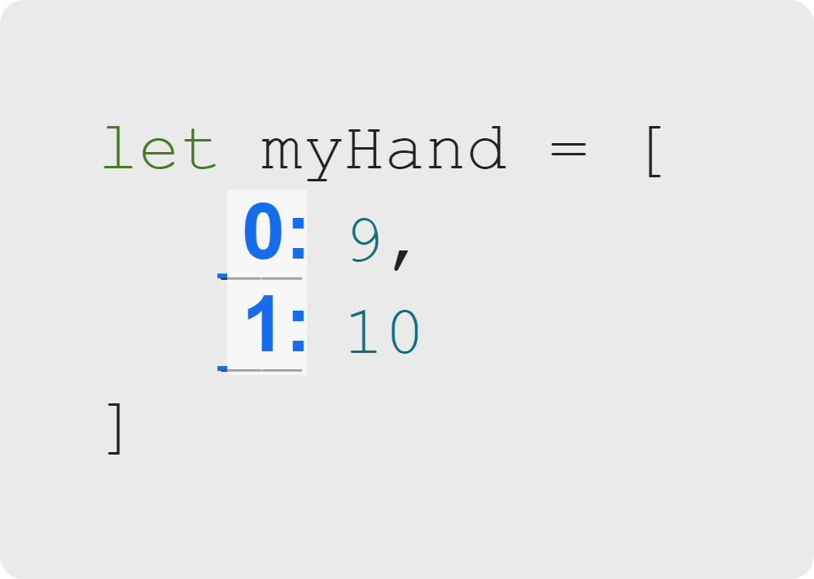
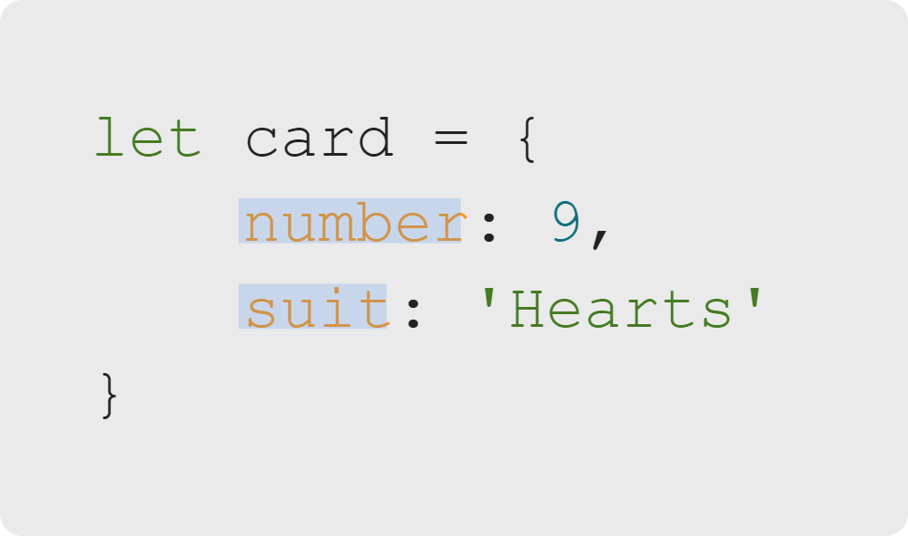
Objects & Properties
Comparing Objects & Arrays
Array Elements
Object Properties
Same: Container for other variables
Same: Container for other variables
Different: Have less meaningful, implicit indexes
Different: Have meaningful, explicit names

Slide 10
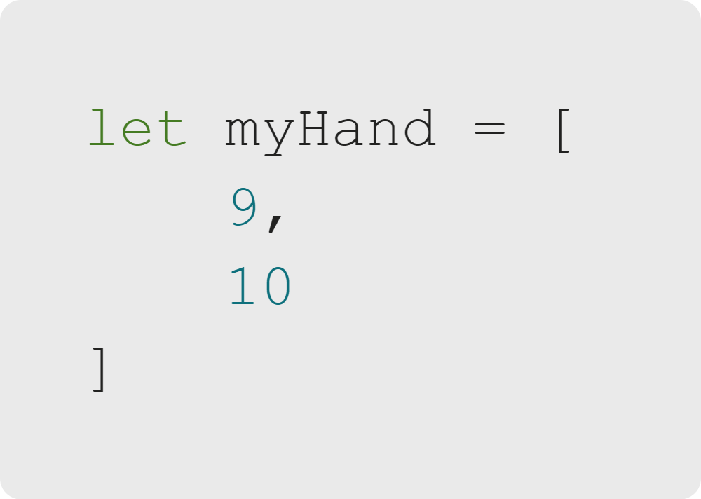
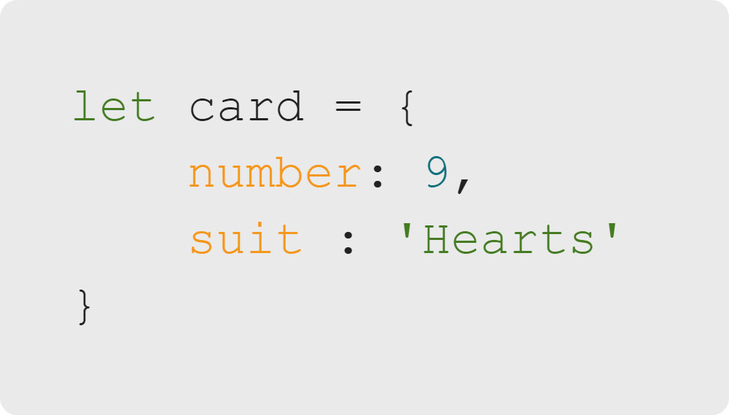
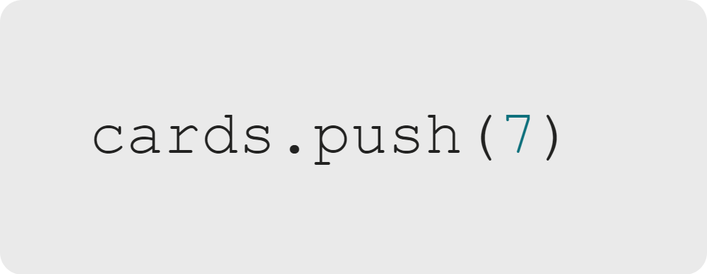
Objects & Properties
Object & Array Differences
Arrays
Objects
Increase and decrease in size
Normally have a known set of properties
'cards' contains two elements.
'card' contains two properties and probably always will.
Now 'cards' contains three elements.
Notes:
Arrays are designed to change size. We can add and remove from them, to model, for example, a player
drawing and playing cards.
In some cases, we might add a property to an object, but this is far less common.

Slide 11

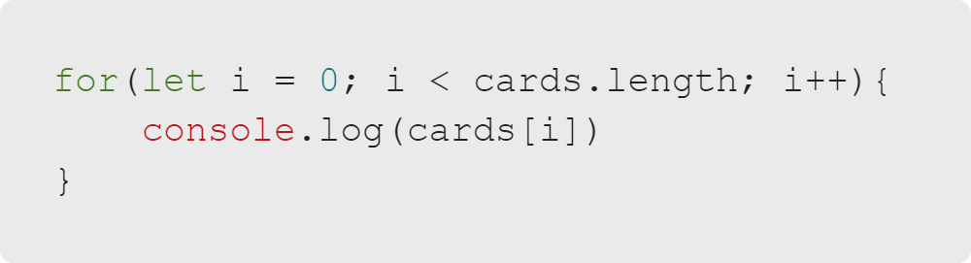
Objects & Properties
Object & Array Differences
Objects
We normally access contents of an object with '.'
Arrays
We normally iterate over the contents of an array.
Notes:
Technically, we can iterate over an object, and we can access array elements by index.
However, because we, as the programmers, know the unchanging properties of an object, it rarely makes sense
to iterate over them.
And because an array can change size, it's rarely useful to try to access an array element by its index.

Slide 12
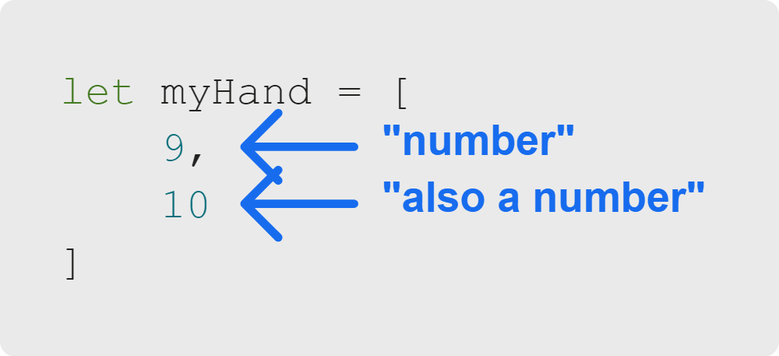
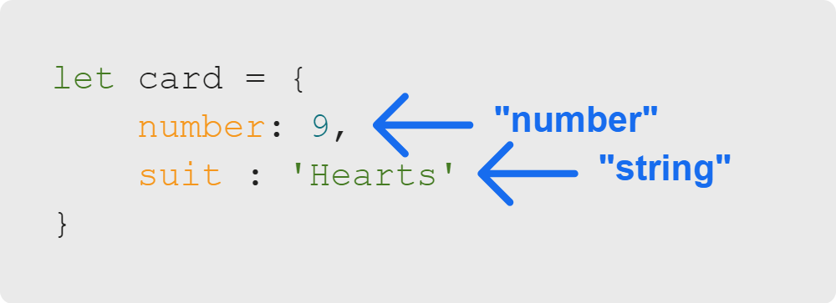
Objects & Properties
Object & Array Differences
Arrays
Objects
Usually have elements of the same type:
Can contain properties of varying types:
Notes:
Arrays can technically contain elements of different types.
But, so that we can iterate over array elements and operate on each one
the same way, we almost always make all elements of an array the same type.
<<Exercise 06 and 07--object and array similarities vs differences>>

Slide 13
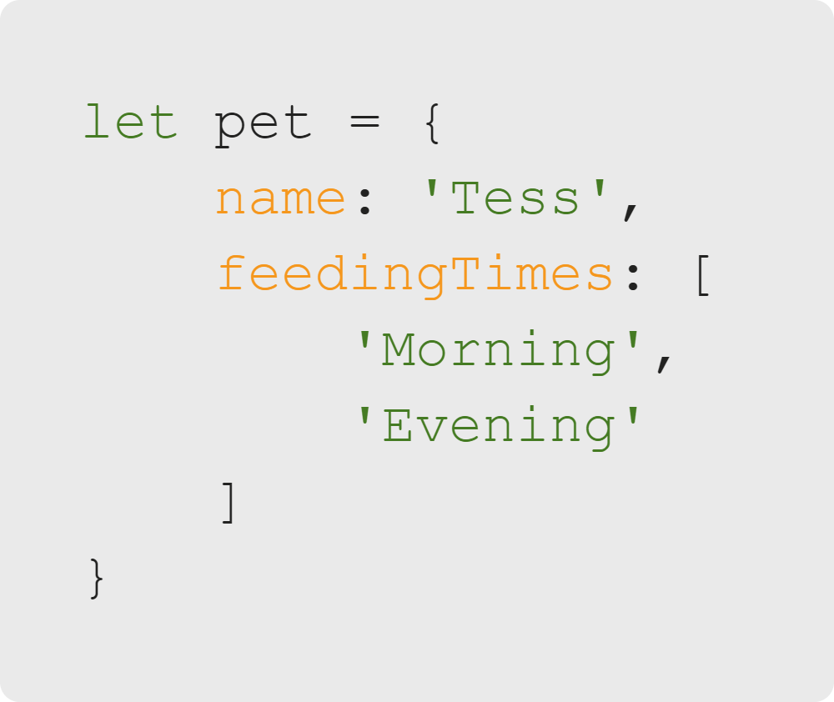
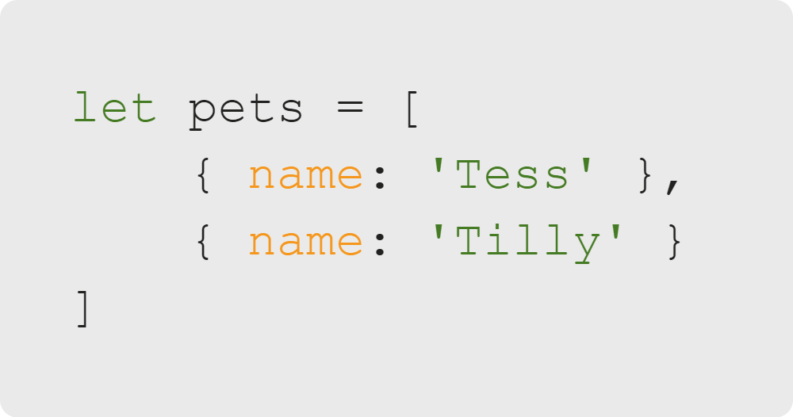
Objects & Properties
Nested Objects & Arrays
Object with an array as a property
Array of Objects
Notes:
Because arrays and objects help us represent different kinds of data, it's often helpful to use them together.

Slide 14
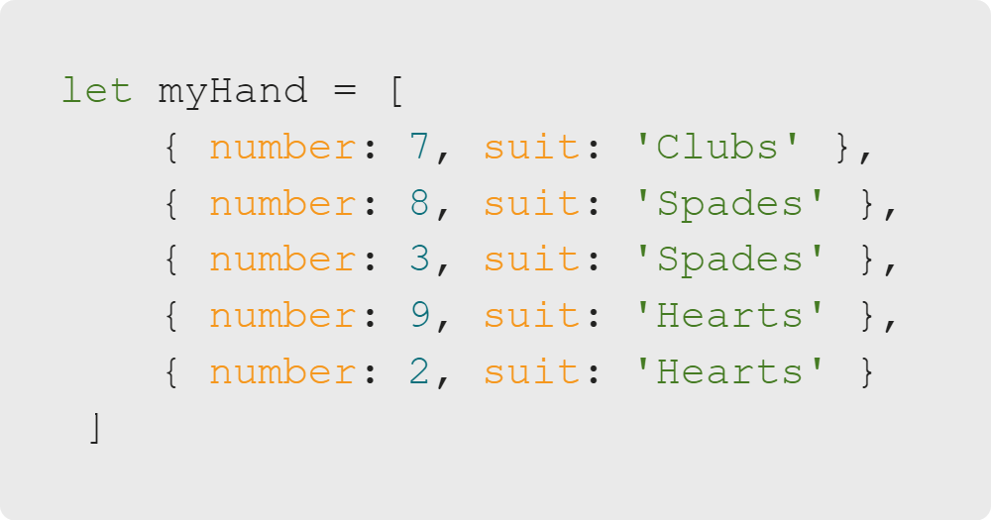
Objects & Properties
Example: Cards
What is the suit of the highest-numbered card in this hand?
Notes:
Using an array of objects, we can solve the problem from the start of the lesson.

Slide 15
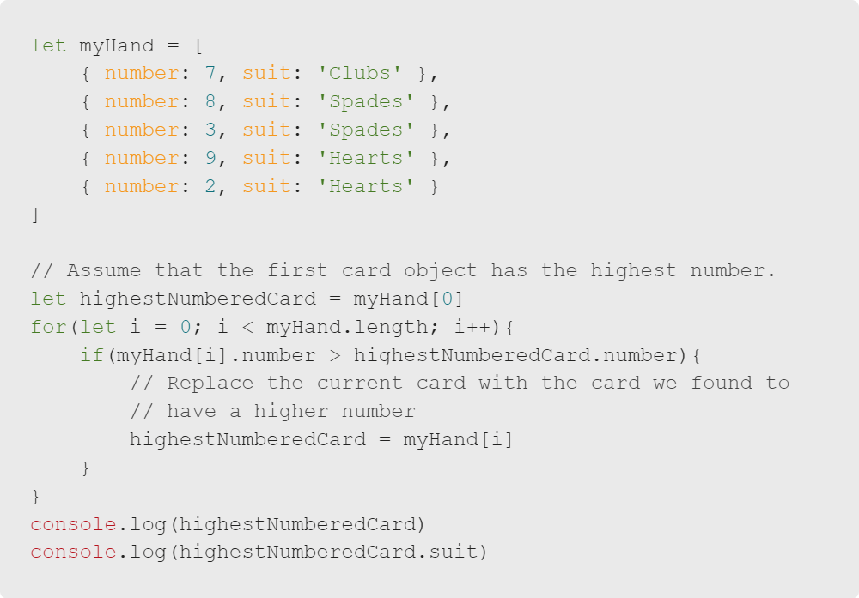


Objects & Properties
Example: Cards
Notes:
Now we can solve the problem from the beginning of the lesson, and find the suit of the highest-numbered card in this hand.

Slide 16
Objects & Properties
Summary
What We've Covered:
Objects & Properties
Defining Objects
Defining Object Properties and Values
Accessing Property Values
Changing Property Values
Differences Between Arrays and Objects
Nested Objects and Arrays
Let's practice accessing nested object properties.

